Slide 1

Training and Placement Management System
Group No. 22
Shifa Tamboli-17104069
Anita Yadav-17104016
Harshita Shah-17104024
Project Guide: Mr. Ganesh Gourshete

Slide 2
Contents
Introduction
Objectives
Problem Definition
Technological Stack
Review Suggestions
Proposed System Architecture/Working
Prototype Design Demonstration.
Plan of Paper Publication

Slide 3
Introduction
This project is aimed at developing an web-based application for the Training and Placement Department of the College.
The system is a web-based application that can be accessed throughout the organization with proper login provided.
Training and Placement Co-ordinators of the college will manage the student information with regard to placement.
System allow the student to upload data and documents after getting verified by training and placement officer.
Administrator and TPO co-ordinator plays an important role in this system.
Recruiters are allowed to access/search students and their information according to their requirements.

Slide 4
Objectives
Arrange and manage the information and CV’s of students according to various streams.
Recruiters information and requirements will be uploaded.
Student can upload their data and documents after getting confirmed by training and placement co-ordinator.
Student will be selected for drives after completing institute based examinations.
To provide Training and Employment opportunities for students .
To provide industry institute interaction.
Recruiters will be able to see the student and college information.

Slide 5
Problem Definition
In various colleges training and placement officers has to collect the information, CV’s of student and manage them properly and arrange them according to various streams.
And if any modification is required it has to be done manually which is a bit tedious.
So, to reduce the job of training and placement officer to manage student and recruiters information new system is proposed which process through the computer.
This system would be total web based application which will manage and arrange student and recruiters information and provide the facility to upload their document.
Here student can search regarding company information and recruiters can also see the details about college and student.
Basically this web based system would be interactive system.

Slide 6
Technological Stack
Hardware requirements
Processor Intel dual core and above
Processor Speed:- 2.1Ghz or more
Hard Disk Space:- 256GB Hard Disk space
RAM:- Minimum:- 2GB DDR3 RAM
Monitor

Slide 7
Software requirements
Operating System :Windows, Linux,ubuntu16.04
Database : MY SQL .
Language: HTML, Java script ,CSS , bootstrap, XML,PHP.
Browser: Google chrome latest version, Mozilla Firefox.

Slide 8
Review Suggestions
College should faculty verify the student document.
Faculty should be notified if student make any changes in profile.
Student will be selected by faculty for upcoming drives on the basis of student performance in institute based examinations.
Result should be displayed of selected students.

Slide 9
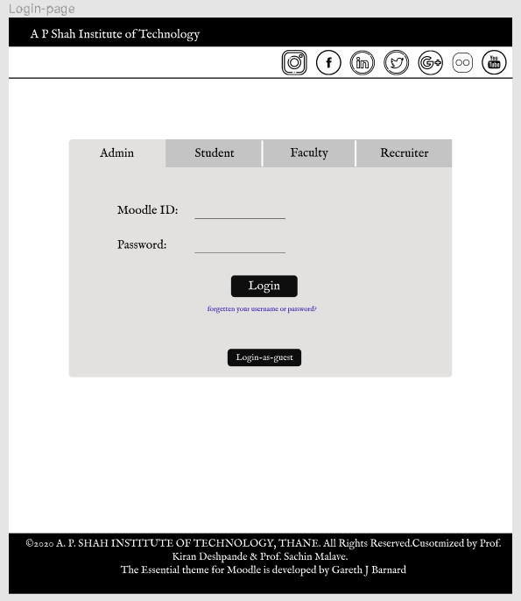
Prototype Design Demonstration
Login-page

Slide 10
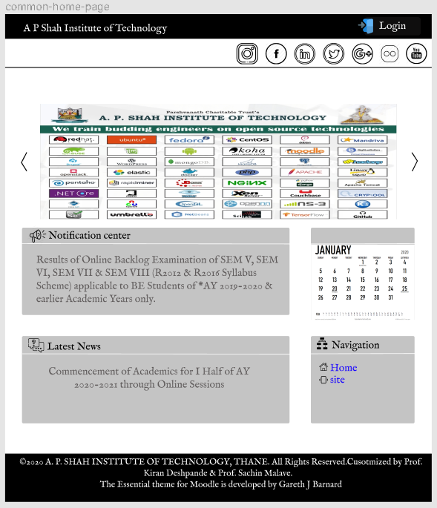
Guest-home-page

Slide 11
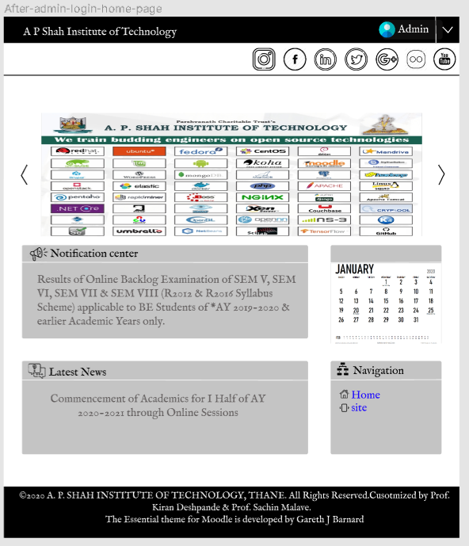
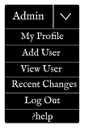
After-admin-login-home-page

Slide 12
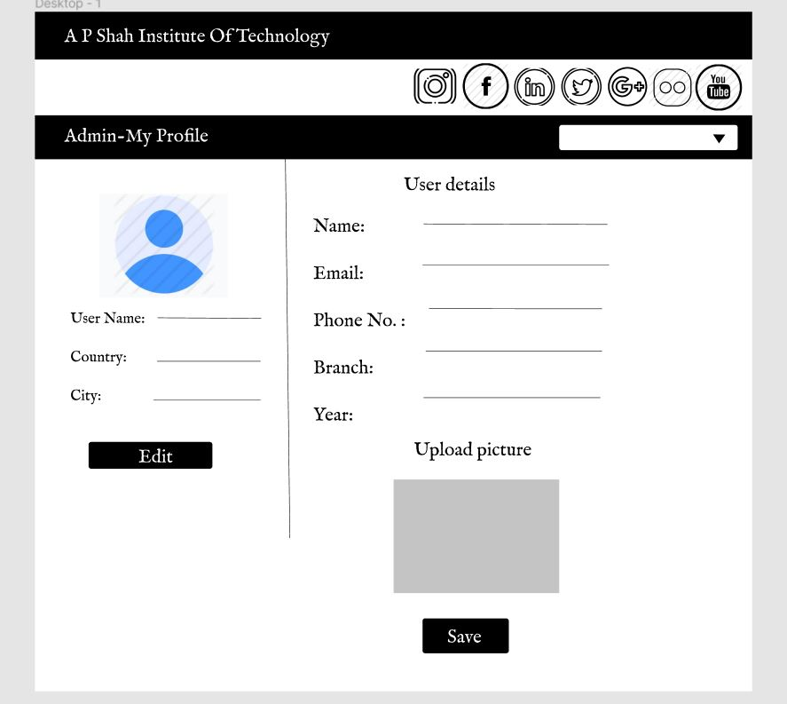
Admin-My profile

Slide 13
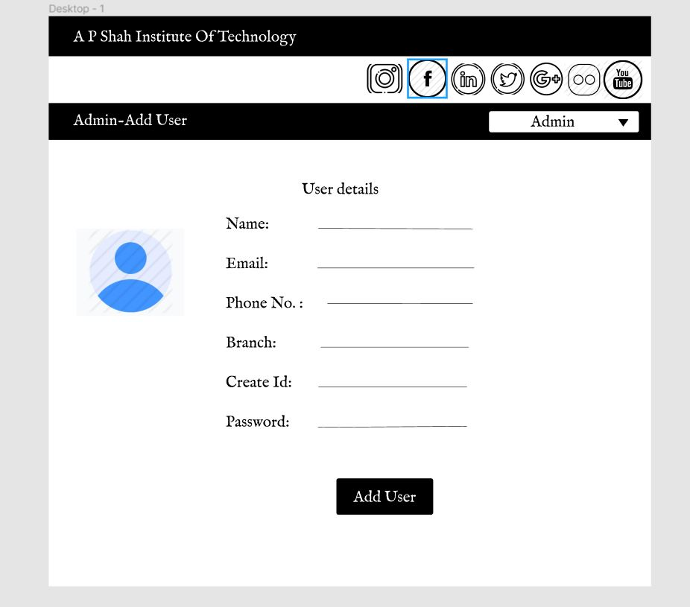
Admin-Add user

Slide 14
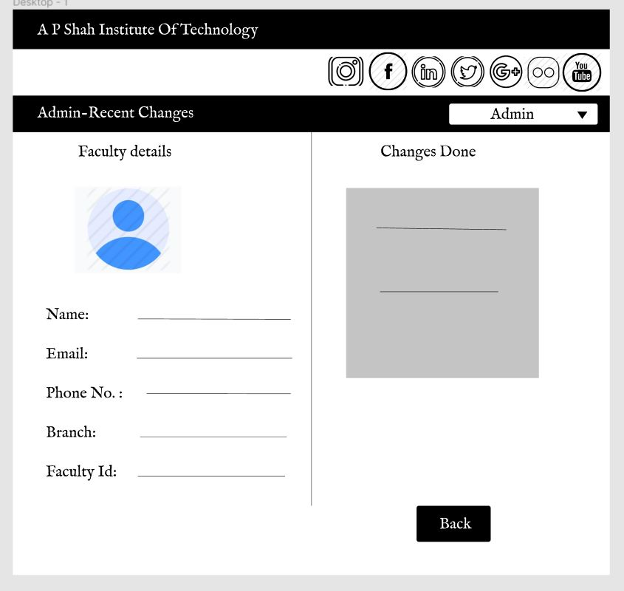
Admin-Recent-changes

Slide 15
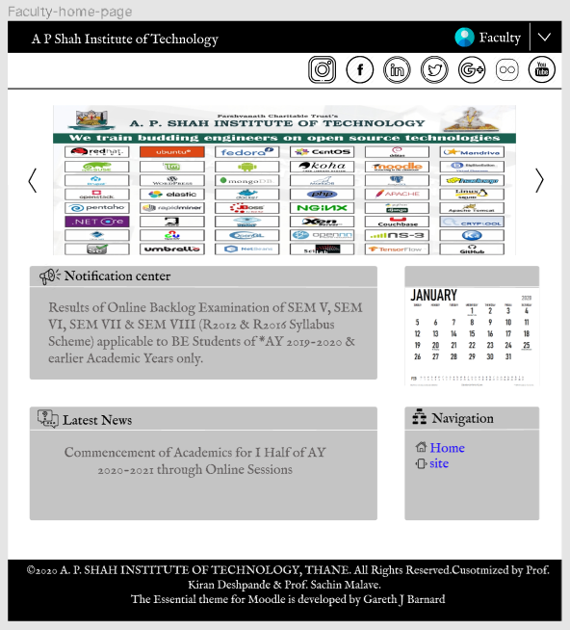
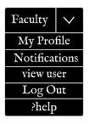
Faculty-home-page

Slide 16
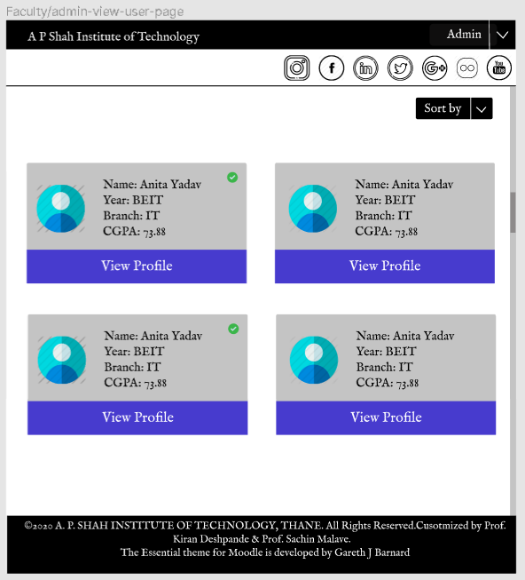
Faculty-admin-view-user-page

Slide 17
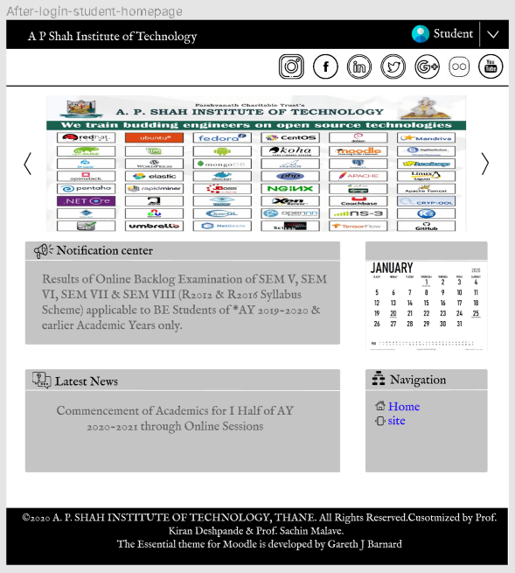
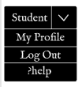
After-login-student-homepage

Slide 18
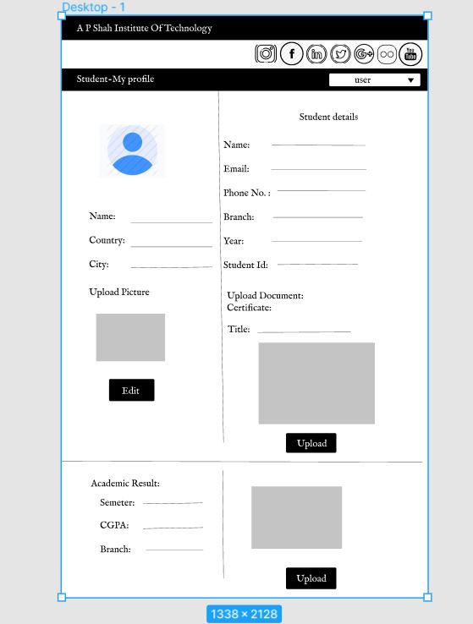
Student profile

Slide 19
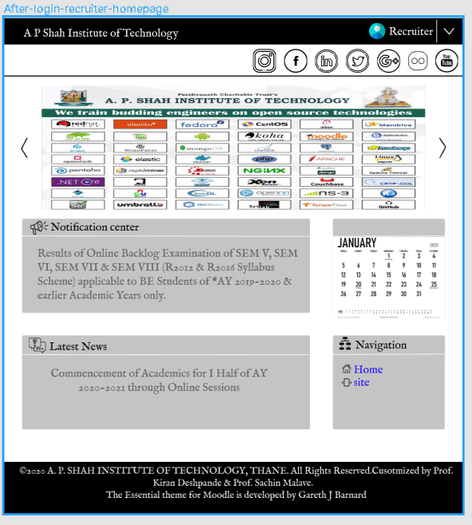
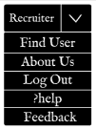
After-login-recruiter-homepage

Slide 20
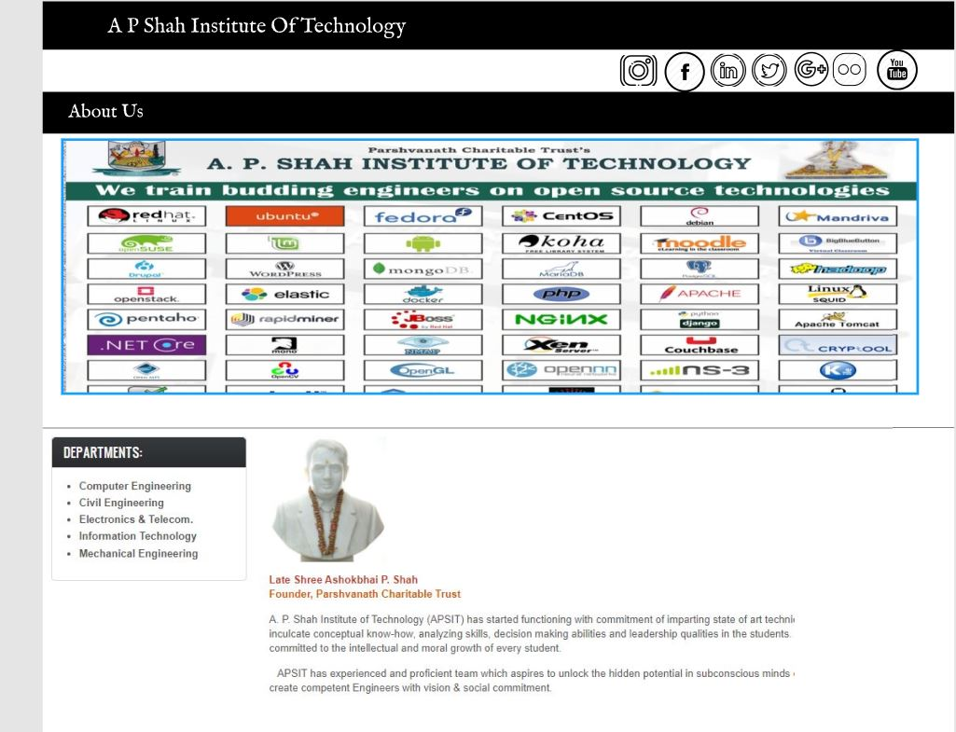
About us

Slide 21
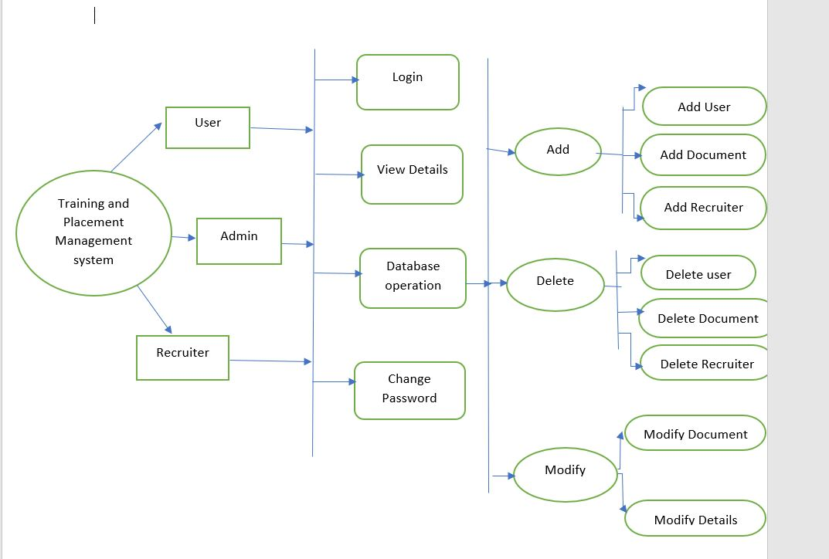
Proposed System Architecture/Working
Confirm by Admin
Final update

Slide 22
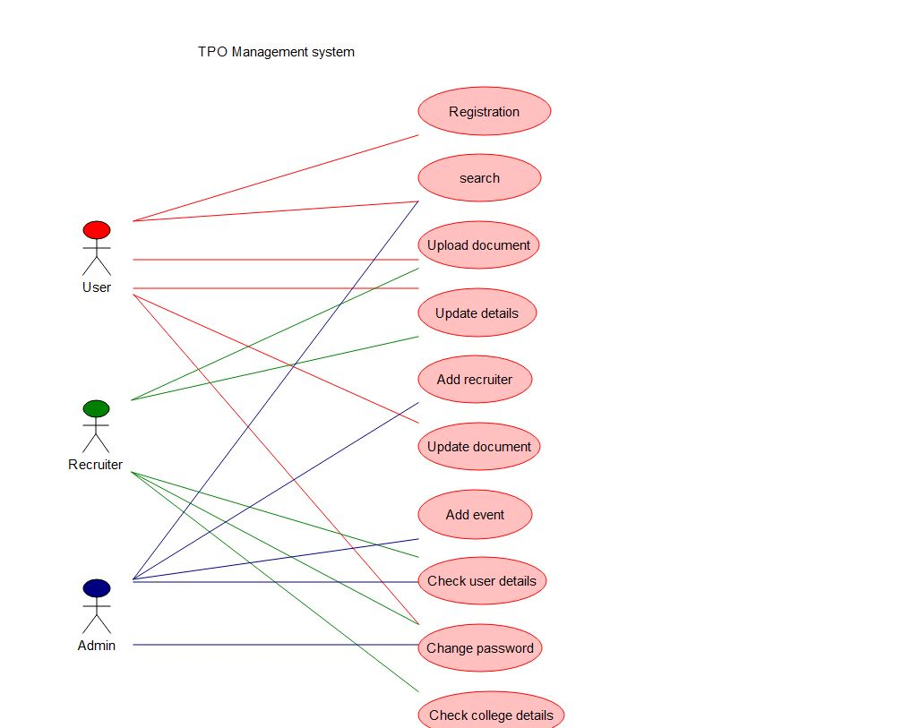
Working
Verify

Slide 23
Thank You...!!

